Slide 1


Dimensions of Biodiversity and Ecosystem Functioning
Open Science For Synthesis
#oss2014
8 August 2014
Pamela Reynolds (UC Davis)
Monica Granados (U. McGill)
Liz Kalies (U. Montana)
Marissa Lee (Duke)
Kes Schroer (Dartmouth)
Notes:
-We are losing biodiversity, especially in marine systems
-We want to know: what are the consequences of losing all these species on functioning? [Define functioning]
-Hundreds of manipulative experiments have been done to answer this question
-Largely they show that the relationship between richness and functioning is saturating: in other words, you see an effect of adding species when richness is low, but beyond a certain point, adding species has a negligible effect on functioning
-Why is this? Likely its because species start to become redundant in terms of their effect on functioning (so many ways to skin a cat)

Slide 2
Dimensions of Biodiversity and Ecosystem Functioning
Open Science For Synthesis
#oss2014
8 August 2014
Pamela Reynolds
Monica Granados
Liz Kalies
Marissa Lee
Kes Schroer
In partnership with Brad Cardinale & OSS 2013:
Jonathan Lefcheck
Isabella Bertani
Iain Caldwell
Shirley Han
Sarah Olson
Notes:
-We are losing biodiversity, especially in marine systems
-We want to know: what are the consequences of losing all these species on functioning? [Define functioning]
-Hundreds of manipulative experiments have been done to answer this question
-Largely they show that the relationship between richness and functioning is saturating: in other words, you see an effect of adding species when richness is low, but beyond a certain point, adding species has a negligible effect on functioning
-Why is this? Likely its because species start to become redundant in terms of their effect on functioning (so many ways to skin a cat)

Slide 3


“The only people more foolish than two people falling in love are scientists starting a collaboration.”
- Bennett & Gadlin. (2012) J. Investig. Med. 60(5): 768–775.
Notes:
The only people more foolish than two people falling in love are scientists starting
collaboration. When passionate about an exciting scientific idea, scientists often neglect to
think realistically about the multiple tasks that will need to be accomplished to construct an
effectively functioning scientific team. All too often collaborative relationships are derailed
by conflicts that emerge because potential tensions, differences and difficulties were not
identified or discussed at the outset of the collaboration. A collaborative research agreement
can pull together many elements discussed in this paper into an overall agreement for how
the various collaborators will work together. It will clearly set expectations, outline roles and
responsibilities, provide contingencies should conflict arise, and state authorship criteria.

Slide 4
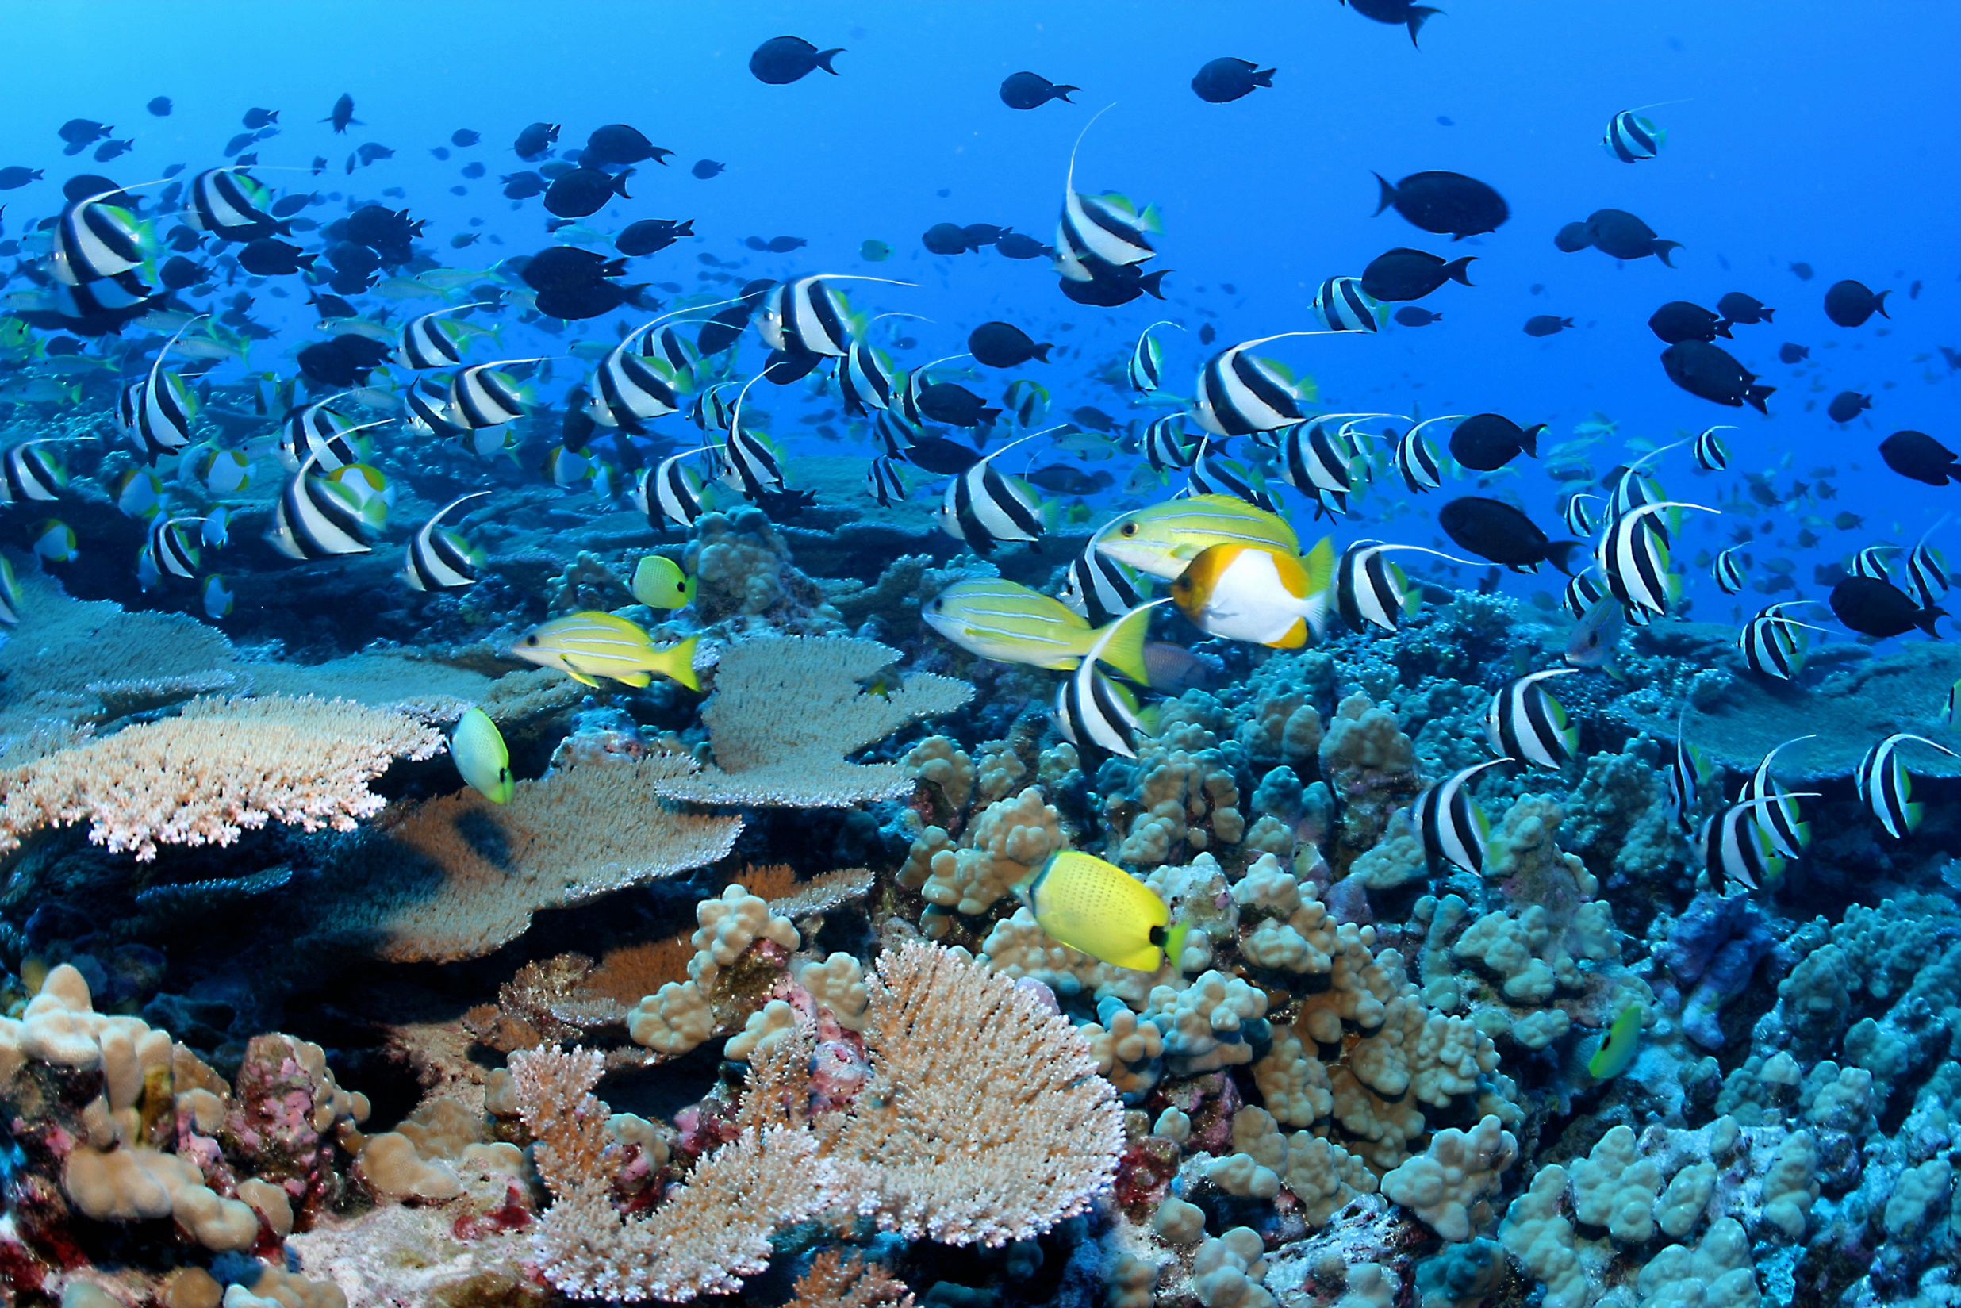
Biodiversity
Notes:
-We are losing biodiversity, especially in marine systems
-We want to know: what are the consequences of losing all these species on functioning? [Define functioning]
-Hundreds of manipulative experiments have been done to answer this question
-Largely they show that the relationship between richness and functioning is saturating: in other words, you see an effect of adding species when richness is low, but beyond a certain point, adding species has a negligible effect on functioning
-Why is this? Likely its because species start to become redundant in terms of their effect on functioning (so many ways to skin a cat)

Slide 5
Biodiversity
"Biological diversity is the variety and variability among living organisms and the ecological complexes in which they occur… [encompassing] different ecosystems, species, genes, and their relative abundance.”
- U.S. Congress Office of Technology Assessment, "Technologies to Maintain Biological Diversity," 1987
Notes:
-We are losing biodiversity, especially in marine systems
-We want to know: what are the consequences of losing all these species on functioning? [Define functioning]
-Hundreds of manipulative experiments have been done to answer this question
-Largely they show that the relationship between richness and functioning is saturating: in other words, you see an effect of adding species when richness is low, but beyond a certain point, adding species has a negligible effect on functioning
-Why is this? Likely its because species start to become redundant in terms of their effect on functioning (so many ways to skin a cat)

Slide 6
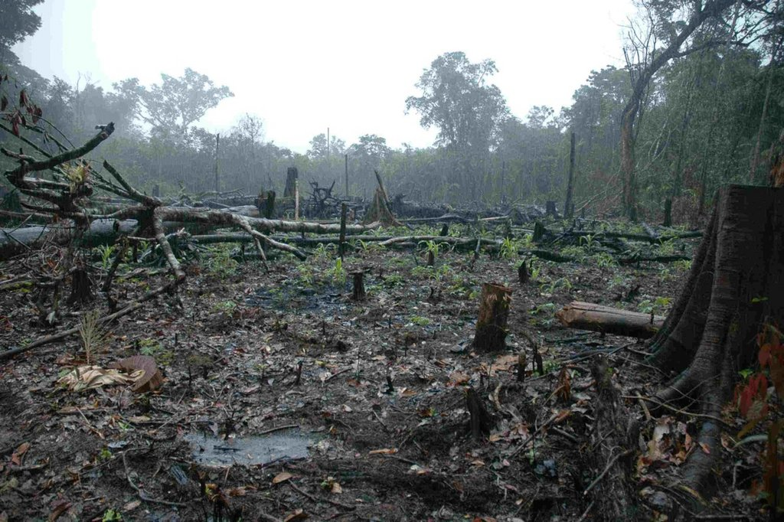
Biodiversity is declining

Slide 7
What are the consequences?
Biodiversity is declining

Slide 8
Ecosystem Functioning
Biodiversity often positively linked with ecosystem functioning
Biodiversity
Notes:
-We are losing biodiversity, especially in marine systems
-We want to know: what are the consequences of losing all these species on functioning? [Define functioning]
-Hundreds of manipulative experiments have been done to answer this question
-Largely they show that the relationship between richness and functioning is saturating: in other words, you see an effect of adding species when richness is low, but beyond a certain point, adding species has a negligible effect on functioning
-Why is this? Likely its because species start to become redundant in terms of their effect on functioning (so many ways to skin a cat)

Slide 9
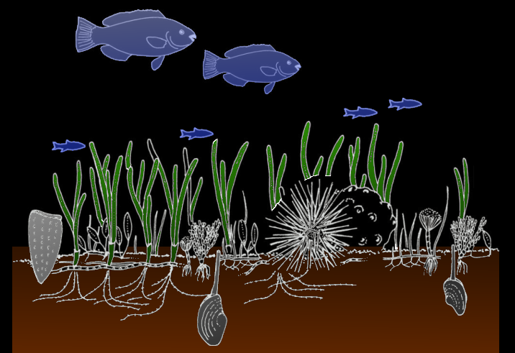
Ecosystem Functioning
Biodiversity often positively linked with ecosystem functioning
Biodiversity
Ecosystem functions
Ecosystem services
2° Production
e.g., Fish growth
Fisheries
1° Production
e.g., Seagrass growth
Sediment stabilization
Resources
e.g., Nutrients
Water clarity
Notes:
-We are losing biodiversity, especially in marine systems
-We want to know: what are the consequences of losing all these species on functioning? [Define functioning]
-Hundreds of manipulative experiments have been done to answer this question
-Largely they show that the relationship between richness and functioning is saturating: in other words, you see an effect of adding species when richness is low, but beyond a certain point, adding species has a negligible effect on functioning
-Why is this? Likely its because species start to become redundant in terms of their effect on functioning (so many ways to skin a cat)

Slide 10
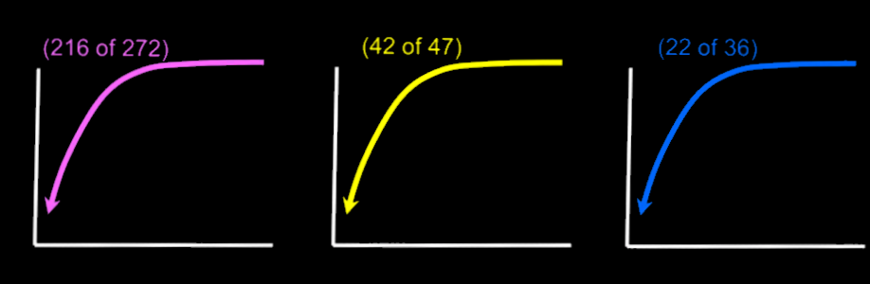
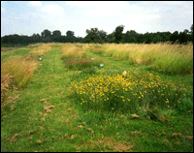
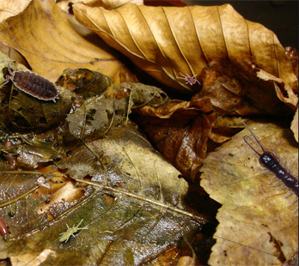
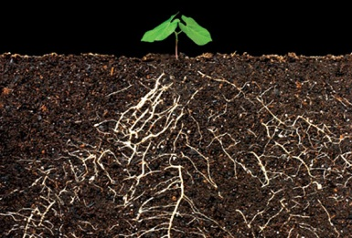
Ecosystem Functioning
Biodiversity often positively linked with ecosystem functioning
Species Richness
Science in a bucket!
Science in a pond!
Science in a field!
Biomass production
Nutrient uptake
Decomposition
Species Richness
Cardinale et al. 2011
Notes:
So we know biodiversity is important. 20 years of controlled experiments has shown that loss of biodiversity, specifically loss of species, results in a decrease in many important ecosystem functions. What is interesting is that, in the majority of these experiments, the relationship between richness and functioning is non-linear and saturating. In other words, at high levels of species richness, species are redundant in their effects on functioning. Thus, the question: how can we better characterize diversity to capture the true variation among species? In other words, how can we account for overlap between species?
- - -
http://www.scientificamerican.com/media/inline/C01CD404-E7F2-99DF-38740B95C496D62E_1.gif
http://utsa.edu/sombrilla/fall2009/img/story-Investigate-plant.jpg
http://www.uni-goettingen.de/admin/bilder/pictures/f62c20b7351fdd81b138bb48e6bbb3fe.jpg

Slide 11
Ecosystem Functioning
Consequences of diversity loss is hard to predict
Species Richness
Relationship between richness and ecosystem functioning is saturating
Cardinale, B. J., Srivastava, D. S., Duffy, J. E., Wright, J. P., Downing, A. L., Sankaran, M., & Jouseau, C. (2006). Effects of biodiversity on the functioning of trophic groups and ecosystems. Nature, 443(7114), 989–992. doi:10.1038/nature05202
Cardinale, B. J., Matulich, K. L., Hooper, D. U., Byrnes, J. E., Duffy, E., Gamfeldt, L., Balvanera, P., et al. (2011). The functional role of producer diversity in ecosystems. American Journal of Botany, 98(3), 572–592. doi:10.3732/ajb.1000364
Notes:
-We are losing biodiversity, especially in marine systems
-We want to know: what are the consequences of losing all these species on functioning? [Define functioning]
-Hundreds of manipulative experiments have been done to answer this question
-Largely they show that the relationship between richness and functioning is saturating: in other words, you see an effect of adding species when richness is low, but beyond a certain point, adding species has a negligible effect on functioning
-Why is this? Likely its because species start to become redundant in terms of their effect on functioning (so many ways to skin a cat)

Slide 12
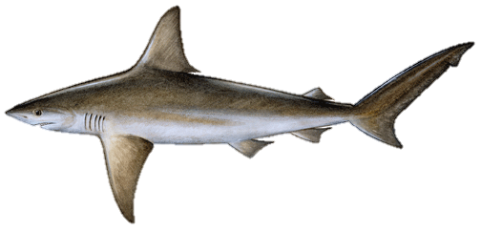
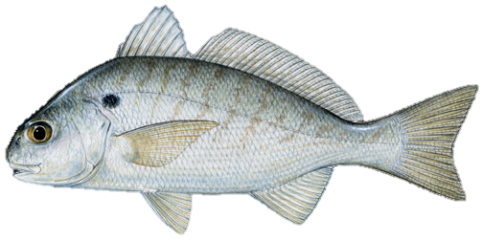
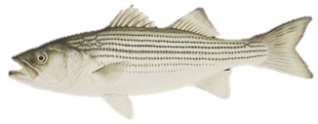
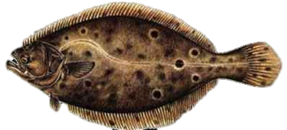
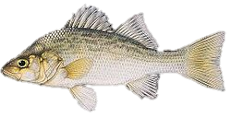
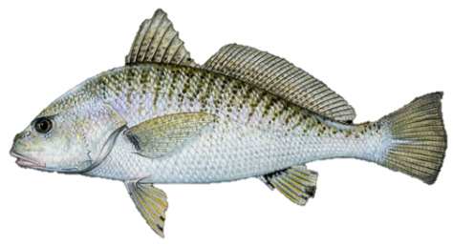
Ecosystem Functioning
Consequences of diversity loss is hard to predict
Species Richness
Relationship between richness and ecosystem functioning is saturating
Cardinale, B. J., Srivastava, D. S., Duffy, J. E., Wright, J. P., Downing, A. L., Sankaran, M., & Jouseau, C. (2006). Effects of biodiversity on the functioning of trophic groups and ecosystems. Nature, 443(7114), 989–992. doi:10.1038/nature05202
Cardinale, B. J., Matulich, K. L., Hooper, D. U., Byrnes, J. E., Duffy, E., Gamfeldt, L., Balvanera, P., et al. (2011). The functional role of producer diversity in ecosystems. American Journal of Botany, 98(3), 572–592. doi:10.3732/ajb.1000364
Notes:
-We are losing biodiversity, especially in marine systems
-We want to know: what are the consequences of losing all these species on functioning? [Define functioning]
-Hundreds of manipulative experiments have been done to answer this question
-Largely they show that the relationship between richness and functioning is saturating: in other words, you see an effect of adding species when richness is low, but beyond a certain point, adding species has a negligible effect on functioning
-Why is this? Likely its because species start to become redundant in terms of their effect on functioning (so many ways to skin a cat)

Slide 13
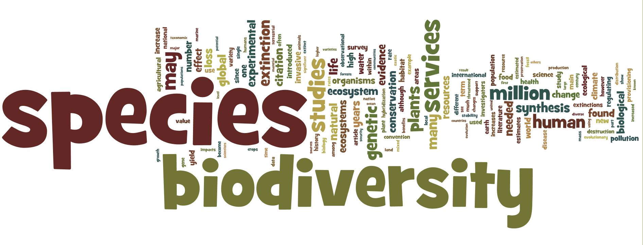
Wordle, Wikipedia definition of “Biodiversity” - August 2014
Notes:
-We are losing biodiversity, especially in marine systems
-We want to know: what are the consequences of losing all these species on functioning? [Define functioning]
-Hundreds of manipulative experiments have been done to answer this question
-Largely they show that the relationship between richness and functioning is saturating: in other words, you see an effect of adding species when richness is low, but beyond a certain point, adding species has a negligible effect on functioning
-Why is this? Likely its because species start to become redundant in terms of their effect on functioning (so many ways to skin a cat)

Slide 14
Biodiversity ≠ species
How can we better characterize diversity to capture natural variation?
Goal: Better ecosystem management and predictions of consequences of diversity loss

Slide 15
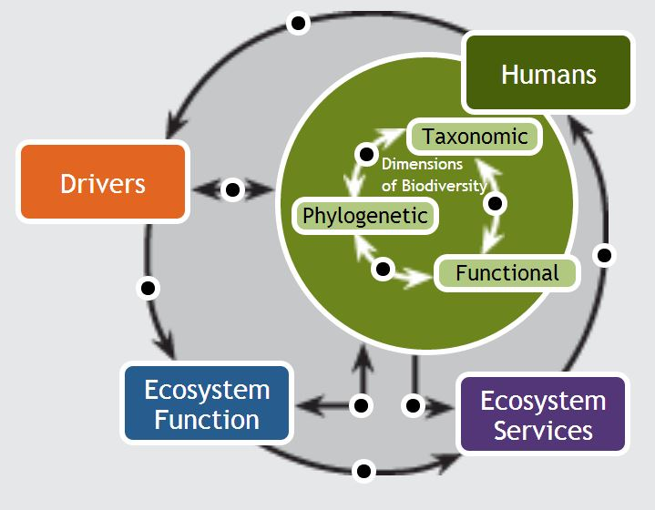
Dimensions of Biodiversity
Species richness number of species
Taxonomic diversity classification distance within the community
Functional diversity community-wide variation in organismal traits
Phylogenetic diversity total amount of phylogenetic distance (genetic variation) in the community
http://www.biodiverseperspectives.com/
Notes:
Several concepts have recently emerged from the existing metrics of diversity: richness, and what I will refer to as “taxonomic diversity” which integrates richness with abundance. The first is “functional diversity”, which considers not only richness and evenness, but adds information about the community-wide variation in organismal functional traits. These are any attribute of an organism—physiological, morphological, behavioral—that define how that organism operates in its environment. The second is “phylogenetic diversity”, which integrates richness and evenness with the total amount of phylogenetic distance in the community. Smaller distances reflect more potential for overlap between species.

Slide 16

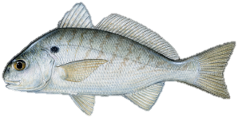
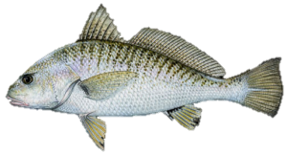
Dimensions of Biodiversity
Species richness number of species
Taxonomic diversity classification distance within the community
Functional diversity community-wide variation in organismal traits
Phylogenetic diversity total amount of phylogenetic distance (genetic variation) in the community
3
KPCOFGS matrix
Trait matrix Genetic matrix
Notes:
Several concepts have recently emerged from the existing metrics of diversity: richness, and what I will refer to as “taxonomic diversity” which integrates richness with abundance. The first is “functional diversity”, which considers not only richness and evenness, but adds information about the community-wide variation in organismal functional traits. These are any attribute of an organism—physiological, morphological, behavioral—that define how that organism operates in its environment. The second is “phylogenetic diversity”, which integrates richness and evenness with the total amount of phylogenetic distance in the community. Smaller distances reflect more potential for overlap between species.

Slide 17
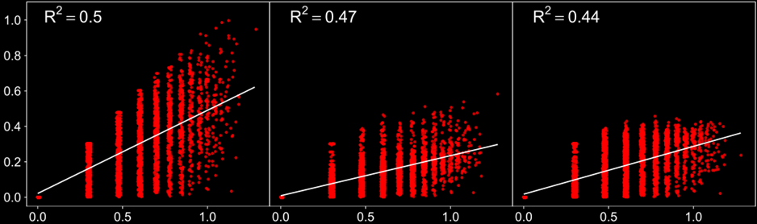
Taxonomic
Functional
Phylogenetic
log₁₀(Diversity)
log₁₀(Species Richness)
Lefcheck et al. 2014 Ecosphere

Slide 18
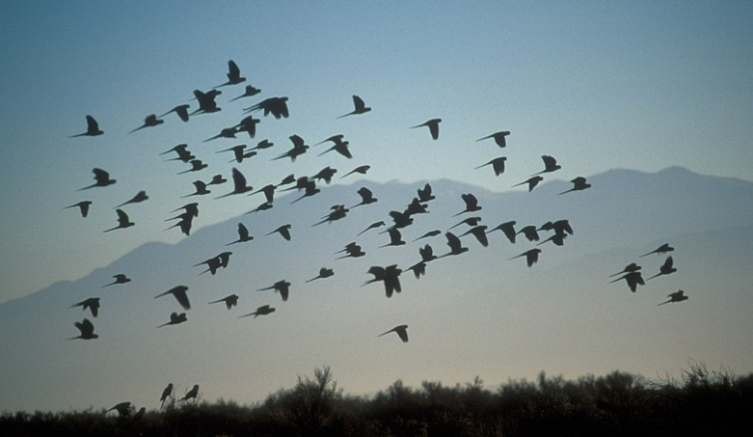
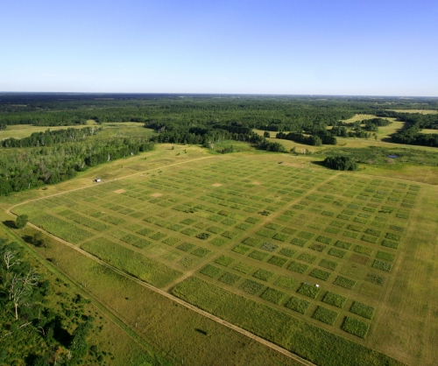
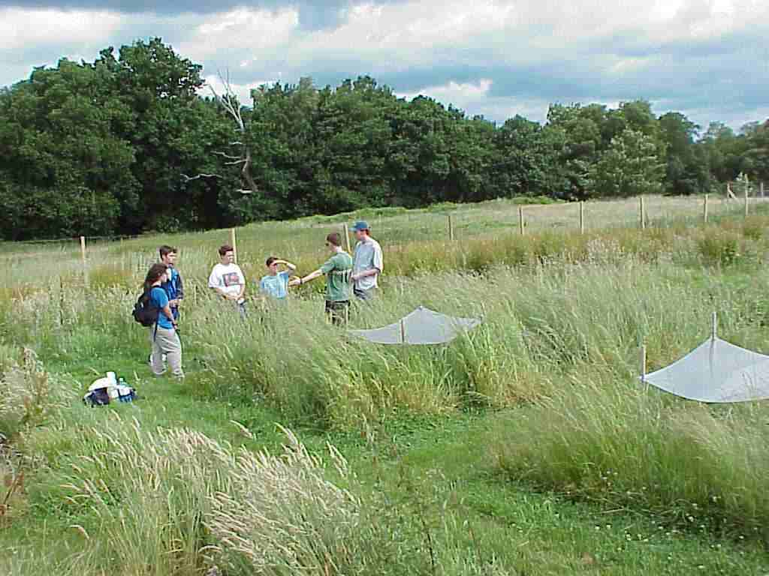
Comparing Dimensions of Biodiversity
Bird communities in France (Devictor et al. 2010, Meynard et al. 2011)
Temperate grasslands in US/Europe (Cadotte et al. 2009, Flynn et al. 2011)
FD & PF can be important predictors
Notes:
Several previous studies have compared these components of diversity. Several publications have looked at spatial patterns in taxonomic, functional, and phylogenetic diversity in bird communities in France, and how they respond to envrionmental drivers. Others have looked at the explanatory power of these components in predicting ecosystem functioning in terrestrial grasslands. But these two examples represent only a small subset of ecosystems, and to date, no studies have considered temporal variation in these components.
- - -
http://www.cedarcreek.umn.edu/research/experiments/e120_full.jpg
http://4.bp.blogspot.com/-bY5NUnqzt24/TbltH70WGVI/AAAAAAAAABo/9LZb3kmGKxU/s1600/JEAL0025-Flock-of-Birds-flying-at-Talampaya-National-Park-La-Rioja-Cuyo.jpg
http://www.sci.sdsu.edu/osrsp/umeb/MVC-005L.jpg

Slide 19
Comparing Dimensions of Biodiversity
Bird communities in France (Devictor et al. 2010, Meynard et al. 2011)
Temperate grasslands in US/Europe (Cadotte et al. 2009, Flynn et al. 2011)
Can we move beyond case studies?
Notes:
Several previous studies have compared these components of diversity. Several publications have looked at spatial patterns in taxonomic, functional, and phylogenetic diversity in bird communities in France, and how they respond to envrionmental drivers. Others have looked at the explanatory power of these components in predicting ecosystem functioning in terrestrial grasslands. But these two examples represent only a small subset of ecosystems, and to date, no studies have considered temporal variation in these components.
- - -
http://www.cedarcreek.umn.edu/research/experiments/e120_full.jpg
http://4.bp.blogspot.com/-bY5NUnqzt24/TbltH70WGVI/AAAAAAAAABo/9LZb3kmGKxU/s1600/JEAL0025-Flock-of-Birds-flying-at-Talampaya-National-Park-La-Rioja-Cuyo.jpg
http://www.sci.sdsu.edu/osrsp/umeb/MVC-005L.jpg

Slide 20
How, generally, do different dimensions of biodiversity correlate with ecosystem functioning?
Goal 1: Better informed design and interpretation of experiments and surveys
Goal 2: Better ecosystem management and predictions of consequences of diversity loss
Notes:
-We are losing biodiversity, especially in marine systems
-We want to know: what are the consequences of losing all these species on functioning? [Define functioning]
-Hundreds of manipulative experiments have been done to answer this question
-Largely they show that the relationship between richness and functioning is saturating: in other words, you see an effect of adding species when richness is low, but beyond a certain point, adding species has a negligible effect on functioning
-Why is this? Likely its because species start to become redundant in terms of their effect on functioning (so many ways to skin a cat)

Slide 21
How, generally, do different dimensions of biodiversity correlate with ecosystem functioning?
Meta-Analyze it!
Cardinale, B. J., D. S. Srivastava, J. E. Duffy, J. P. Wright, A. L. Downing, M. Sankaran, C. Jouseau, M. W. Cadotte, I. T. Carroll, J. J. Weis, A. Hector, and M. Loreau. 2009. Effects of biodiversity on the functioning of ecosystems: A summary of 164 experimental manipulations of species richness. Ecology (Data Paper), 90:854.
Notes:
-We are losing biodiversity, especially in marine systems
-We want to know: what are the consequences of losing all these species on functioning? [Define functioning]
-Hundreds of manipulative experiments have been done to answer this question
-Largely they show that the relationship between richness and functioning is saturating: in other words, you see an effect of adding species when richness is low, but beyond a certain point, adding species has a negligible effect on functioning
-Why is this? Likely its because species start to become redundant in terms of their effect on functioning (so many ways to skin a cat)

Slide 22
Original database: Cardinale et al. 2009
(1421 experiments)
Notes:
Cardinale et al 2009 Abstract. Over the past decade, accelerating rates of species extinction have prompted an
increasing number of studies to reduce the number of species experimentally in a variety of
ecosystems and examine how this aspect of diversity alters the efficiency by which communities
capture biologically essential resources and convert them into new tissue. Here we summarize
the results of 164 experiments (reported in 84 publications) that have manipulated the richness
of primary producers, herbivores, detritivores, or predators in a variety of terrestrial and
aquatic ecosystems and examined how this impacts (1) the standing stock abundance or
biomass of the focal trophic group, (2) the abundance or biomass of that trophic group’s
primary resource(s), and/or (3) the extent to which that trophic group depletes its resource(s).
Our summary includes studies that have focused on the top-down effects of diversity, whereby
researchers have examined how the richness of trophic group t impacts the consumption of a
shared resource, and also studies that have focused on the bottom-up effects of diversity,
whereby researchers have examined how the richness of trophic group t impacts consumption
of t by the next highest trophic level. The first portion of the data set provides information
about the source of data and relevant aspects of the experimental design, including the spatial
and temporal scales at which the work was performed. The second portion gives the
magnitude of each response variable, the standard deviation, and the level of replication at
each level of species richness manipulated. The third portion of the data set summarizes the
magnitude of diversity effects in two ways. First, log ratios are used to compare the response
variable in the most diverse polyculture to either the mean of all monocultures or the species
having the highest/lowest value in monoculture. Second, data from each level of species
richness are fit to three nonlinear functions (log, power, and hyperbolic) to assess which best
characterizes the shape of diversity effects. The final portion of the data set summarizes any
information that helps parse diversity effects into that attributable to species richness vs. that
attributable to changes in species composition across levels of richness.
Key words: biodiversity; ecosystem efficiency; ecosystem functioning; ecosystem

Slide 25
Effect on functioning
Individual study
Diversity Metric
Notes:
-We are losing biodiversity, especially in marine systems
-We want to know: what are the consequences of losing all these species on functioning? [Define functioning]
-Hundreds of manipulative experiments have been done to answer this question
-Largely they show that the relationship between richness and functioning is saturating: in other words, you see an effect of adding species when richness is low, but beyond a certain point, adding species has a negligible effect on functioning
-Why is this? Likely its because species start to become redundant in terms of their effect on functioning (so many ways to skin a cat)

Slide 26
Preliminary analysis: No clear correlation between effect size and species richness
Species Richness

Slide 27
Methods
Original database
Cardinale et al. 2009
(193 studies)
Removed non-additive experiments
(24 studies)
Extracted species names
(169 studies)
Removed studies missing information and unresolved taxonomy
(15 studies)
Phylogenetic matrix
Taxonomic matrix
(154 studies)
Functional matrix
Build phylogeny
Build taxonomic trees
Build functional trees
Compare distances (diversity metric) with effect size
Notes:
Original database:
194 studies across a variety of ecosystems
575 experiments manipulating diversity and measurements of ecosystem functions
~700 species (excluding microbes)

Slide 28
Methods
Original database
Cardinale et al. 2009
(193 studies)
Removed non-additive experiments
(24 studies)
Extracted species names
(169 studies)
Removed studies missing information and unresolved taxonomy
(15 studies)
Populate genetic matrix
(subset)
Populate taxonomic matrix
(154 studies)
Populate trait matrix
(subset)
Effect size
Effect size
Effect size
Build phylogeny
Build functional trees
PD
TD
FD
Compare distances (diversity metric) with effect size
Notes:
Original database:
194 studies across a variety of ecosystems
575 experiments manipulating diversity and measurements of ecosystem functions
~700 species (excluding microbes)

Slide 29
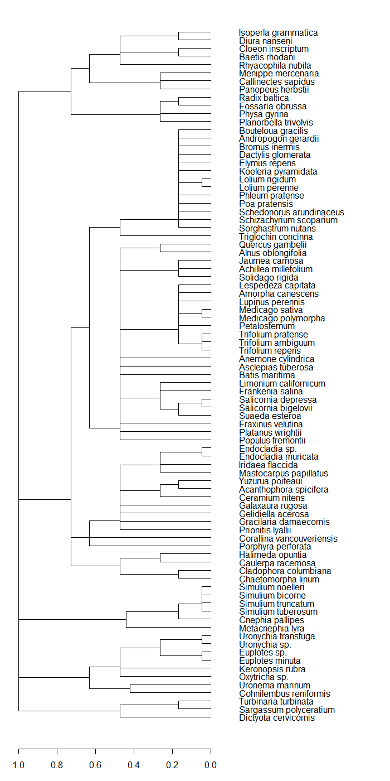
Taxonomic Diversity
Inverts
Populate taxonomic matrix
(775 species)
Grasses
monocot
Manual
entry
Taxize R script
Eudicots
Build taxonomic trees (custom R script)
Red Algae
Green Algae
Flies
Extract taxonomic distances (custom R script)
Brown Algae
Notes:
Can rotate nodes in ape (function called rotate) so flies are up closer to inverts

Slide 30

Functional Diversity
Populate functional matrix
Explore taxa list
Populate trait matrix
Decide upon suite of traits
Body size
Growth rate
Extract distance measures
Generation time
Extract / collate data
Reproductive mode
Reproductive output
Integrate & revise
Build functional trees
Notes:
Original database:
194 studies across a variety of ecosystems
575 experiments manipulating diversity and measurements of ecosystem functions
~700 species (excluding microbes)

Slide 31
Functional Diversity
For 10 studies (82 species), full trait set found for 1.5 studies (7 species ).
Populate functional matrix
X
Explore taxa list
Populate trait matrix
Decide upon suite of traits
Body size
Growth rate
Extract distance measures
Generation time
Extract / collate data
Reproductive mode
Reproductive output
Integrate & revise
Build functional trees
Notes:
Original database:
194 studies across a variety of ecosystems
575 experiments manipulating diversity and measurements of ecosystem functions
~700 species (excluding microbes)

Slide 32
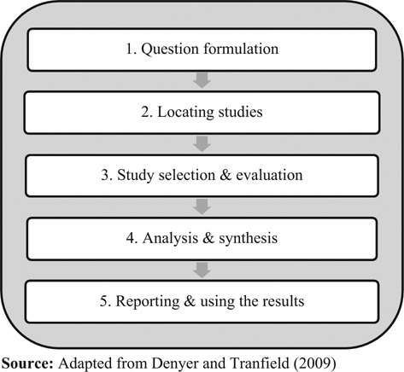
Systematic Review Approach: What traits are used to assess functional diversity?

Slide 33

Systematic Review Methods: PRISMA Flow Diagram
Records identified through Web of Science & Scopus searching (n = 303)
Additional records identified through other sources (e.g., Google Scholar) (n = )
Key Words:
1: "functional diversity" OR "functional biodiversity“
2: "trait based" OR "trait-based“ AND *diversit*
Identification
Records after duplicates removed (n = ~350)
Screening
Full-text articles assessed for eligibility by all group members
Full-text articles excluded, with reasons (n = ? )
Studies included in qualitative synthesis (n = ideally >75 )
Included

Slide 34
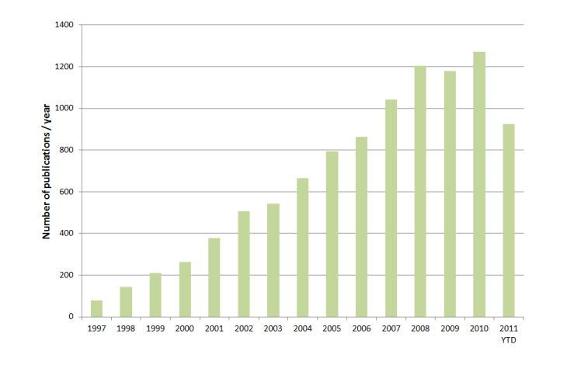
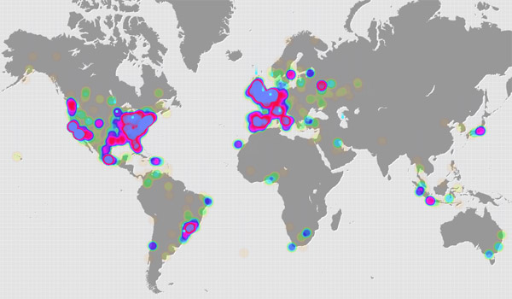
Systematic Review
Rate of increase in publications on topic
Prevalence of studies across ecosystem types
Biases in number and type of traits used across systems
Patterns in trait selection on diversity effect
Candidate trait set per taxa for functional matrix Table of traits by taxa

Slide 35
Functional Diversity
Goal: “top” 10 traits per taxa per study
Populate functional matrix
Explore taxa list
Populate trait matrix
Decide upon suite of traits
Systematic Review
Extract distance measures
Extract / collate data
Integrate & revise
Build functional trees
Notes:
Original database:
194 studies across a variety of ecosystems
575 experiments manipulating diversity and measurements of ecosystem functions
~700 species (excluding microbes)

Slide 36
Phylogenetic Diversity
Pull relevant genes for different groups (i.e., COI)
Compile multiple sequence file
GenBank online tools
Command line
Align multiple sequences
(Clustal-Omega)
Mask poorly conserved sequences
(Gblocks)
Derive guide tree
Pretty up the tree
Derive pairwise distances
R, ape package

Slide 37
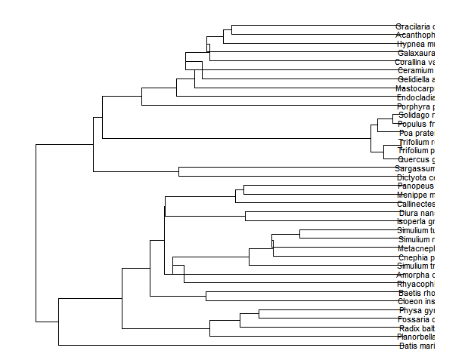
Example phylogeny (from subset, COI)
Algae
Plants
Flies
Snails
?!

Slide 38
Goals
http://www.biodiverseperspectives.com/
Notes:
Several concepts have recently emerged from the existing metrics of diversity: richness, and what I will refer to as “taxonomic diversity” which integrates richness with abundance. The first is “functional diversity”, which considers not only richness and evenness, but adds information about the community-wide variation in organismal functional traits. These are any attribute of an organism—physiological, morphological, behavioral—that define how that organism operates in its environment. The second is “phylogenetic diversity”, which integrates richness and evenness with the total amount of phylogenetic distance in the community. Smaller distances reflect more potential for overlap between species.

Slide 39
Project Goals
Functional trait assessment - systematic review
Extract data (by December)
Synthesis meeting mid-December
Write review in winter 2015
Dimensions of biodiversity meta-analysis
Populate trait matrix (by February)
Extract distance metrics, analyze against effect sizes (by April)
Write paper in spring 2015
Submit before OSS 2015!
Tools: R, OpenMEE
Notes:
Original database:
194 studies across a variety of ecosystems
575 experiments manipulating diversity and measurements of ecosystem functions
~700 species (excluding microbes)

Slide 40

Image: woodleywonderworks Flicker Stream

Slide 41
Troubleshooting phylogenetics
Gblocks is great for distantly related taxa, but it conflates variation in closely related taxa. What’s the effect on the ultrametric tree?
Many organisms aren’t genetically represented and congeners are used instead.
Plants are poorly resolved by the COI barcode; other barcodes may need to be employed for certain clades.
Right now, sequences are pulled by hand from Genbank to ensure quality and ease alignment. Is it possible to automate this for 700+ species with a lot of search parameters?
(continued on next slide)

Slide 42
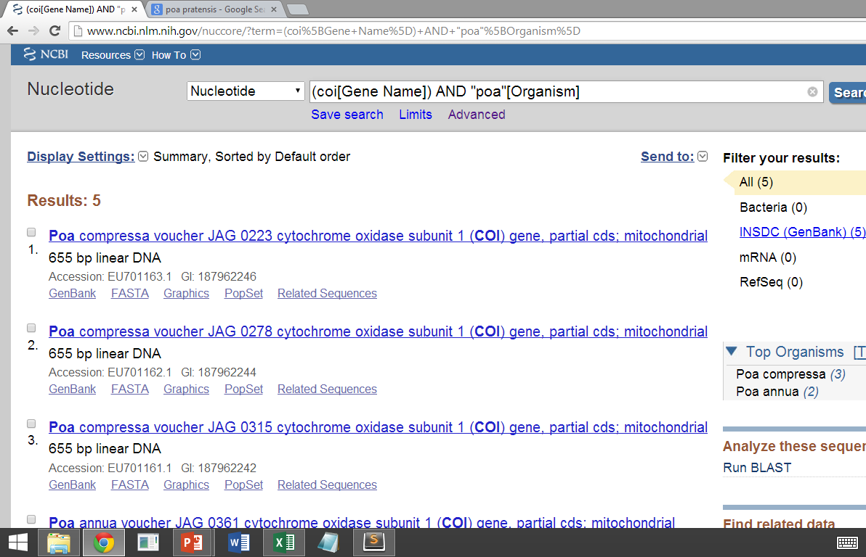
Troubleshooting phylogenetics
Must use GenBank search terms for quality control
May need to use different barcodes
Have to watch minimum and maximum lengths; first hit is not always the right one
Unvouched specimens are treated differently
Hits may involve multiple congeners and only 1 should be selected

Slide 43
Problems
How does the variety of plants and animals in a community contribute to environmental goods and services? Is it about how many, or is it about how different they are?
Benefits
Identifying relevant diversity measurements can help to set goals for sustainable conservation and management.
So What
We are losing species at an unprecedented rate, yet we don’t know the consequences of this loss for human well-being.
Issue
How does biodiversity sustain life on earth?
Solutions
Accounting for similarity among plants or animals can be used to better understand how diversity and environmental goods and services are related.

